Slide 1
PROJECT IDEA PRESENTATION
MOBILE APPLICATION DEVELOPMENT
PRESENTED BY: SANJINEE BSCS-VII
INSTRUCTOR: SIR ADIL KHAN
SUKKUR IBA UNIVERSITY KANDHKOT CAMPUS

Slide 2
Pizza Ordering App

Slide 3
Introduction & Background
The traditional telephone order food has inconvenience to the customers and the food delivery store.
The online food ordering system provides convenience for the customers. It overcomes the disadvantages of the traditional queuing system.
This system increases the takeaway of foods than visitors.
Therefore, this system enhances the speed and standardization of taking the order from the customer.
It provides a better communication platform. the user’s details are noted electronically.

Slide 4
Scope
Users:
module to place their orders and order details
Register: User can register and get login
Login: User can login using credentials.
Profile: User can set their profile.
Change Password: User can change their password..
Menu: list of Menu with price, details and photos. Filter menu by Kind of Pizza, Cart Page - Modify deleted items, Order Confirmation/Payment/COD etc.
Orders: Users can view the previous and current order history and also can track the order.

Slide 5
Scope
Delivery Boy
Login: Delivery boy can login using credentials.
Profile: they can set their profiles.
Change Pass: They can change password.
Orders: - only todays orders will be shown, it will show Completed/Pending list, Order details with Restaurant and User Information, Continuous Location Updates and Change status i.e. Parcel Picked/Delivery InProgress/Delivered

Slide 6
Advantages and Limitations
Advantages
For those who are disabled and elderly, who cannot get out of the house, people who don’t have anybody to physically support them, the food ordering app is very useful.
No need to waste time standing in long queues.
When we order food more regularly and get familiar with all the deals and discounts, we can avail the benefits during special occasions.
Limitation
Data need to be entered properly otherwise, outcome may won’t be accurate.

Slide 7
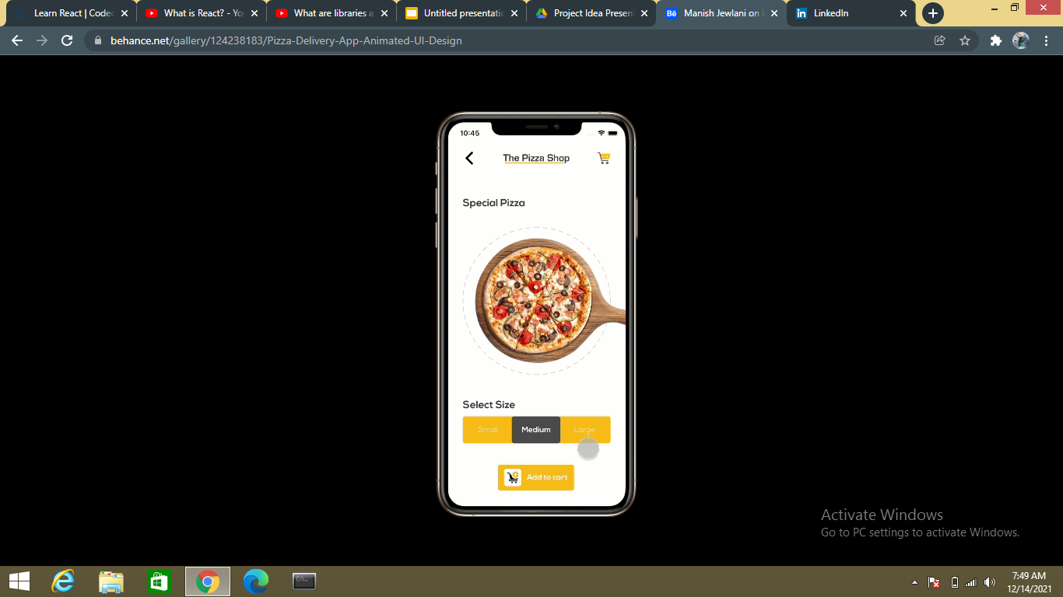
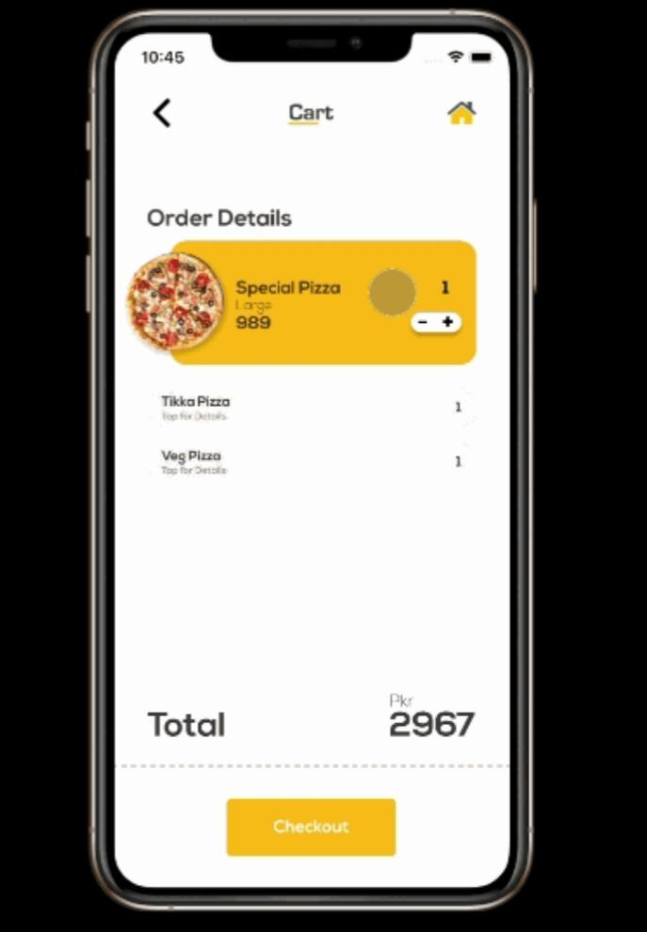
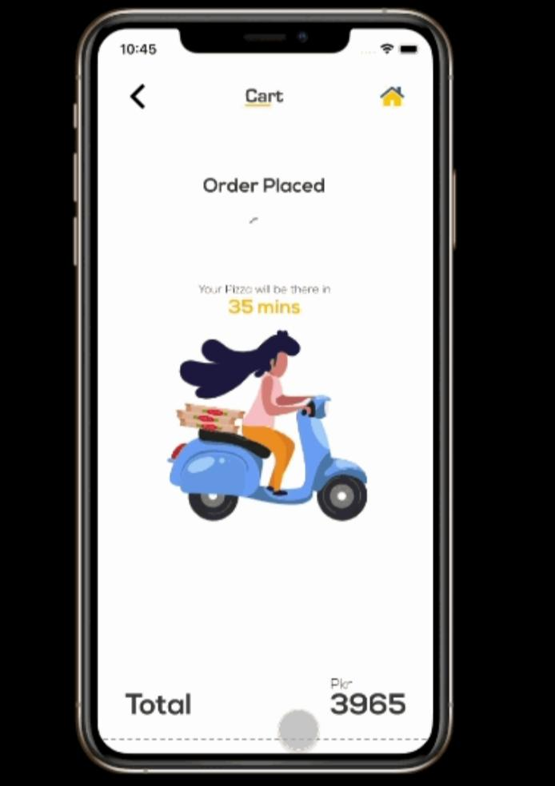

Slide 8



Technologies
Frontend Backend Database

